Slide 1
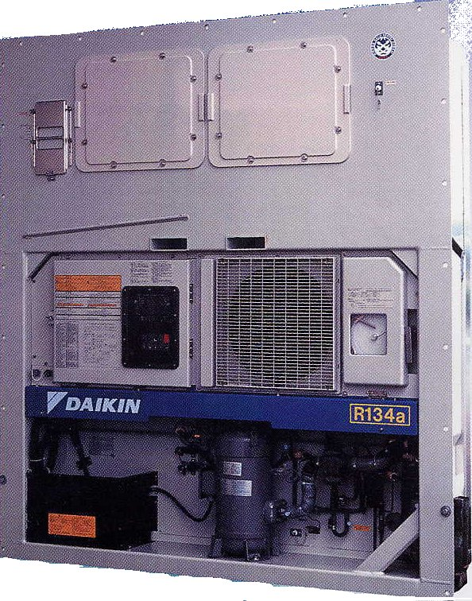
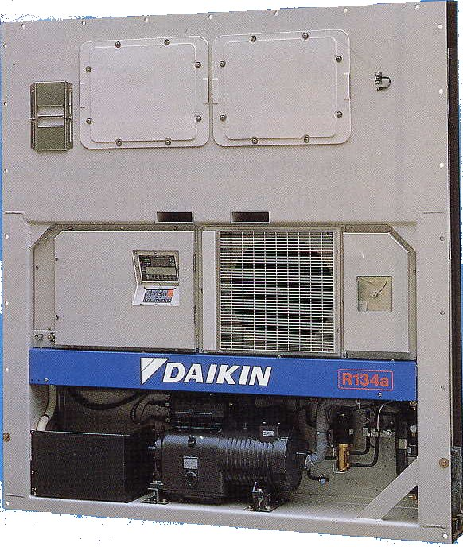
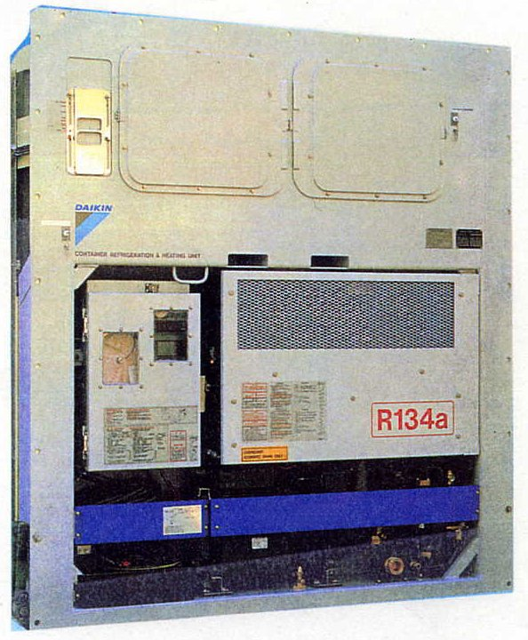
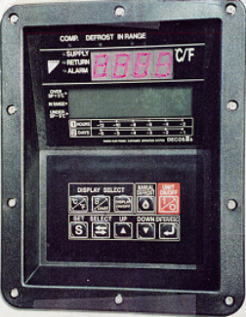
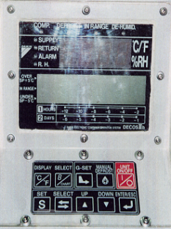
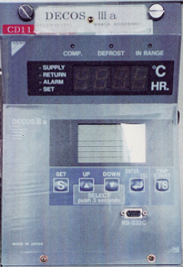
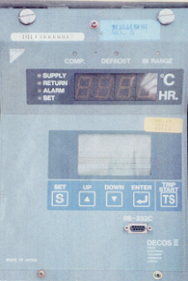
DAIKIN CONTAINER
LXE10C (A)
LXE5C
LXE10E-A
LXE10D
2002～
1998～
1994 ~1997
DECOSⅢc
DECOSⅢb
DECOSⅢa
DECOSⅢ

Slide 2
DIFFERENCES BETWEEN DAIKIN AND OTHERS:
No electrical heaters
Electronic expansion valve
Different types of defrost
Chartless function

Slide 3
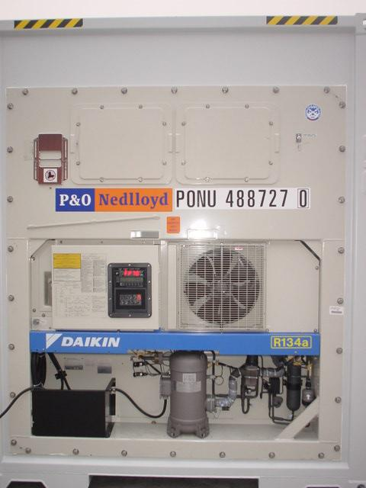

Slide 4
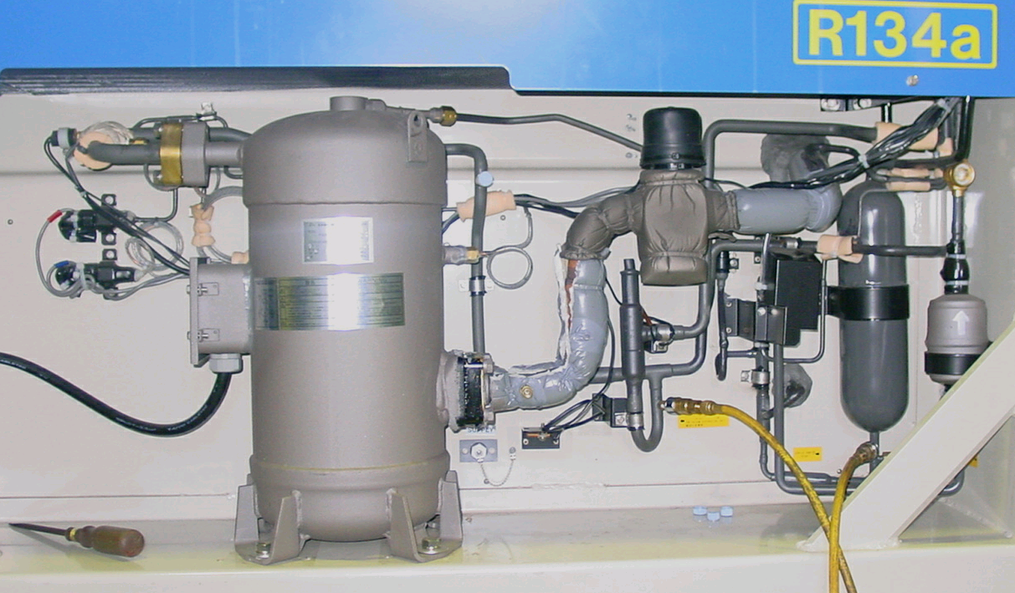
PIPING from Outer View
LXE10E-A
Liquid Indicator
DCHS
HPS
HPT
LPT
Receiver
Sensor (Red)
AMBS
Valve (Blue)
DPR
LSV
② ①
SGS
SMV
Drier
Service Port
④ ⑤ ③

Slide 6
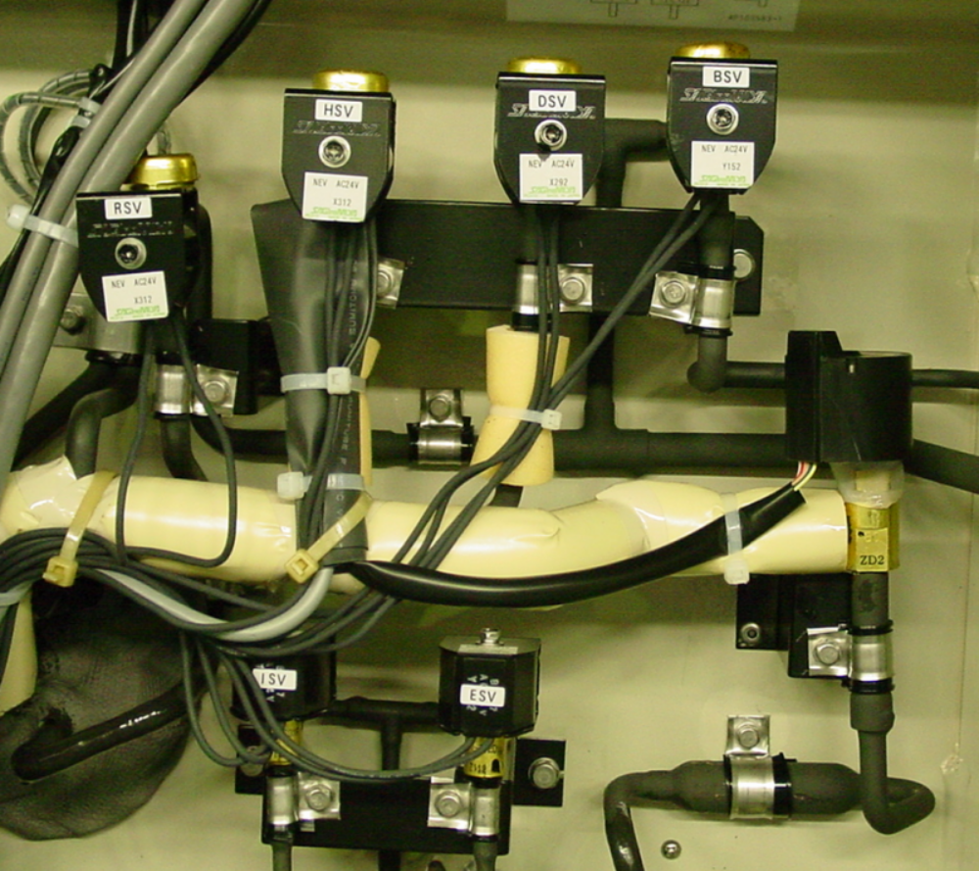
PIPING from Outer View
LXE10E-A
HSV DSV BSV
※RSV
※RSV for Dehumidification Control (option)
EV
ISV ESV

Slide 7
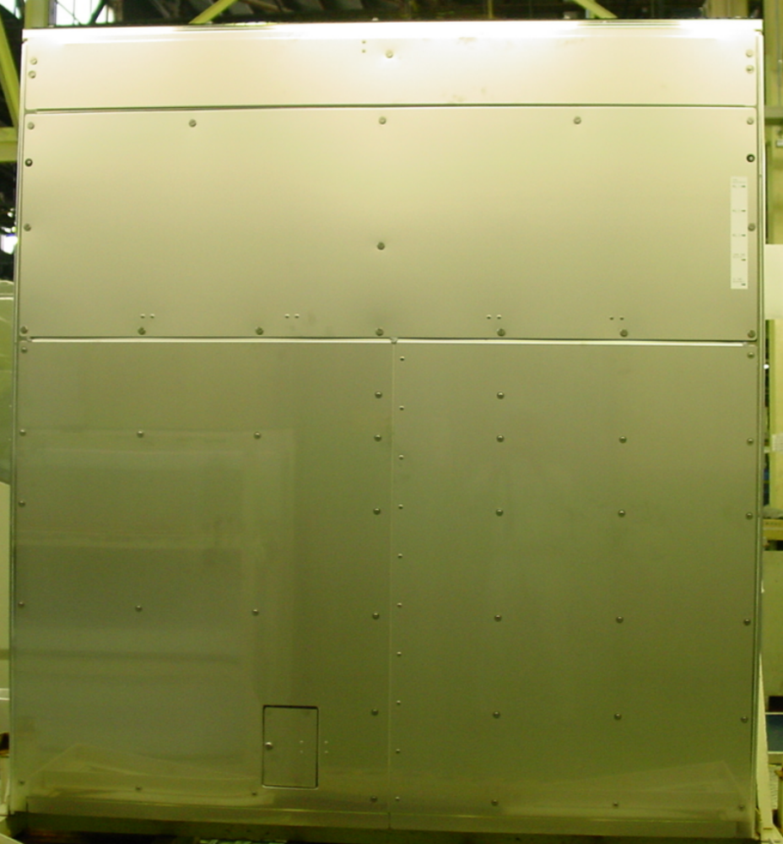
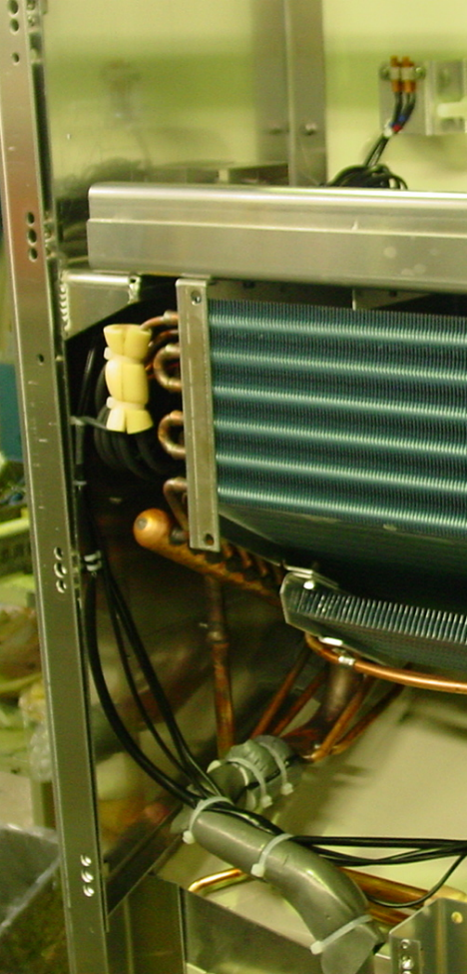
Inter View
LXE10E-A
EIS
RS/DRS/RRS
Removable Upper Plate
Removable Lower Plate
EOS
SS/DSS/RSS
USDA & Cargo Temp.
Receptacles (option)

Slide 8
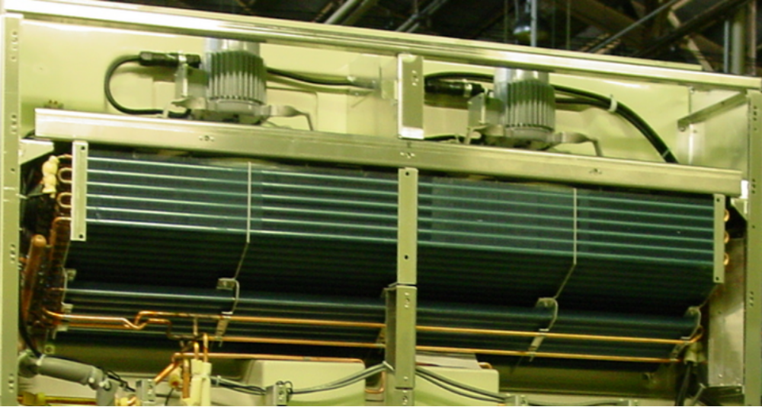
Inter View
LXE10E-A
Evaporator
※ Re-Heater
Drain Pan Heater
※Re-Heater for Dehumidification Control (option)

Slide 9
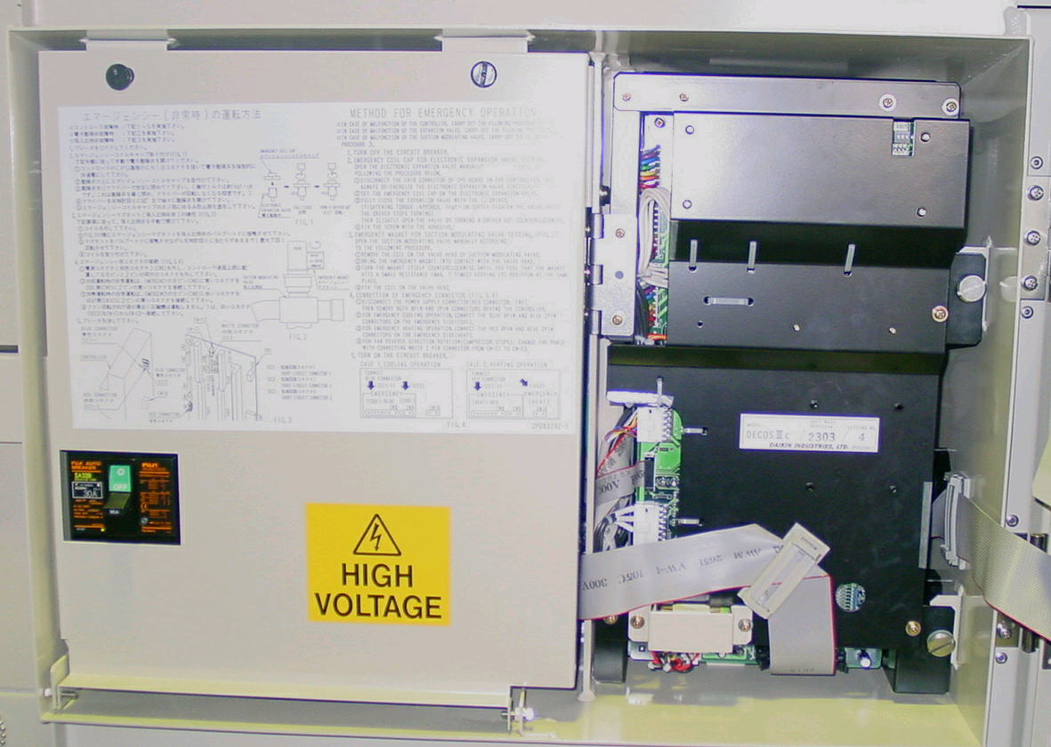
CONTROL BOX
LXE10E-A
C/B Switch
CONTROLLER
（DECOSⅢC）

Slide 10
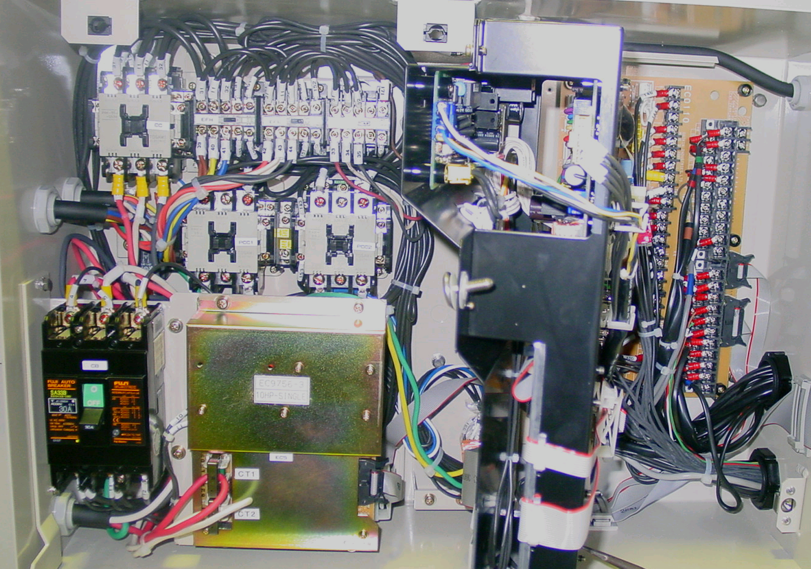
CONTROL BOX
LXE10E-A
CC
EFH
EFL
CFC
RPP
Terminal
Board
TB2
(Output B.)
TB1
(Input B.)
PCC1
PCC2
C/B
PTCT Board CONTROLLER
PTCT Board
MODEM (option)
CONTROLLER
Tr C (400V→24V,13V) under PTCT Board

Slide 11
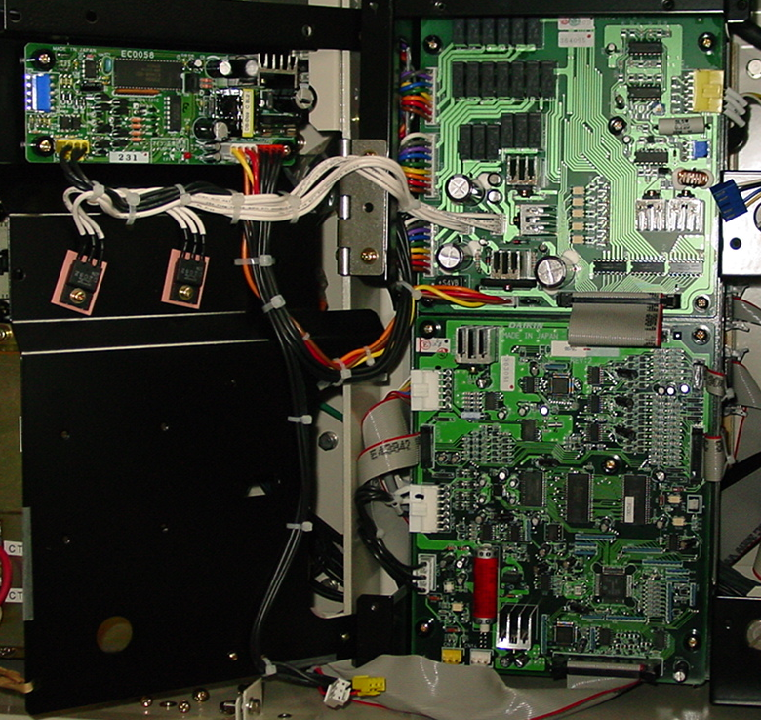
CONT. INSIDE
Fuse 7
CN84
EC6
EC2 I/O Board
SMV Adapter Board
CN83 CN82 CN81
CN18
CN17
CN16
CN15
CN11
CN12
EC１ CPU Board
CN19 CN14

Slide 12
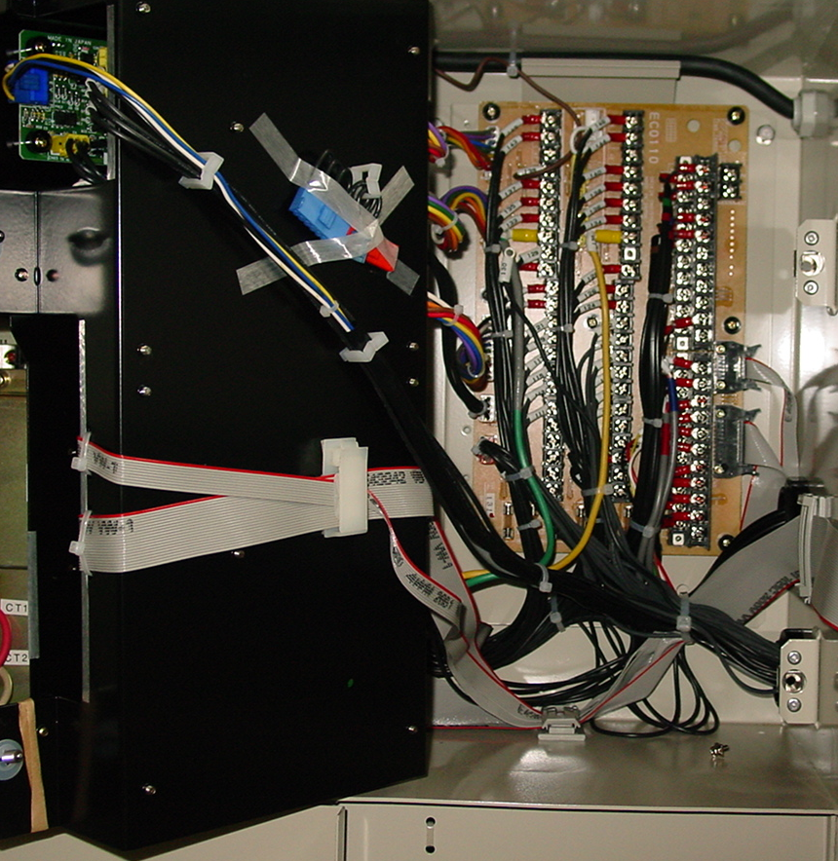
CONT. REAR
Back of Controller
Terminal Board
Short circuit connector for emergency operation
SCC1-2 (Red)
SCC2 (Blue)
SCC1-1 (Blue)

Slide 13

TERMINAL BOARD
Reverse phase correction socket
Connection Socket for Short Circuit Connector at emergency operation
45 43 41 39 37 35 33 31 29 27
46 44 42 40 38 36 34 32 30 28
CN3
3937 35 3331 29 27 25 23 21
4038 36 3432 30 28 26 24 22
21
CN8
CN2
CN9
CN10
CN7
25 23 21 19 17 15 13 11 09 07 05 03 01
26 24 22 20 18 16 14 12 10 08 06 05 04
CN1
1917 15 1311 09 07 05 03 01
2018 16 1412 08 06 04 02 n
CN4
Power Supply ( 24V & 13V )
CN5
CN6
TB1 Input Terminal Board
Fuse No.1 to 6
Fu6 Fu5 Fu4 Fu3 Fu2 Fu1
TB2 Output Terminal Board

Slide 14
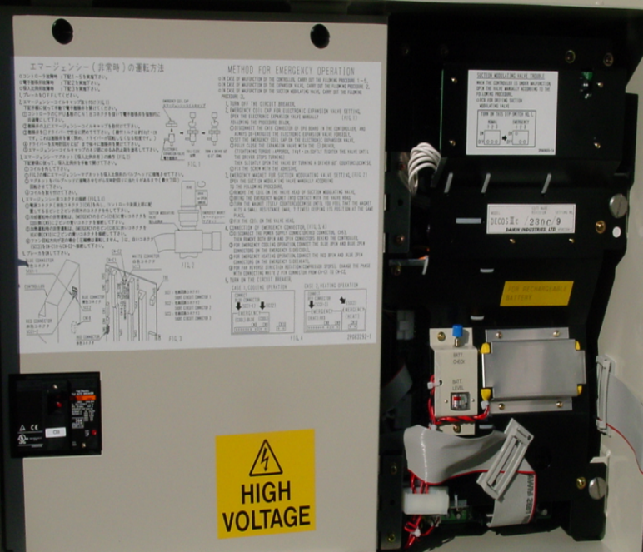
LXE10E－A14,A15
Rechargeable Battery
for Data Memory
Battery Check Button

